Slide 1
Investigating multiple scattering with McStas
James Tricker
Mantid Vacation Student

Slide 2
Multiple scattering
Can minimise MS in experiments by using a sample that is:
Small in comparison with its mean free path.
Strongly absorbing
The aim of the correction is to make is seem as that the intensity distribution picked up by detectors is due to purely single scattering events and that there are no artefacts due to absorption

Slide 3

Integrating over a sample:
dV₁
l₁
l₁₂
l₂
dV₂
Trying to do this rapidly becomes intensive
Luckily
The neutron intensity undergoes exponential decay as it passes through a sample
Can simplify the calculation in some cases

Slide 4
What can Mantid do currently?
Mayers Sample Correction
Multiple Scattering Cylinder Absorption (MSCA)
Muscat
First two assume the sample is a cylinder and that scattering is elastic and isotropic - essentially restricted just to vanadium
Muscat is quite dated and not widely used but in principle a good general method

Slide 5
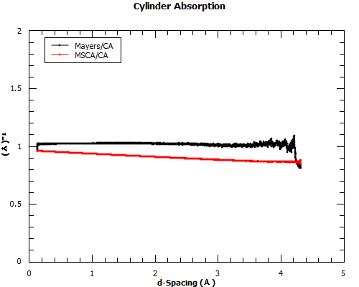
Cylinder absorption

Slide 6
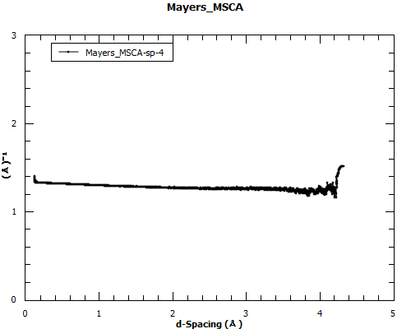
Full comparison

Slide 7

A general tool for simulating neutron scattering instruments and experiments
Great for multiple scattering investigation. Can track how many times individual neutrons have scattered before detection.

Slide 8
Suggested approach utilising McStas
Generate a scattering function S = S(Q) or S(Q, omega) from the data in question using Mantid
Making the assumption that multiple scattering for S does not contain multiple scattering and is good first order approximation of the true S of the sample
Insert this S into a McStas component and do a McStas simulation where the output of this simulation is separated into single and multiple scattered neutrons

Slide 9
Mantid and McStas
From the McStas instrument file generate the IDF file for Mantid.
Compile the McStas c code. (Remember to link correctly to NeXus libraries)
Run McStas simulation with the NeXus flag on to produce event data for Mantid.
This can already by somewhat automated
Research being done to bring OFF to Mantid
Always improving interoperability

Slide 10
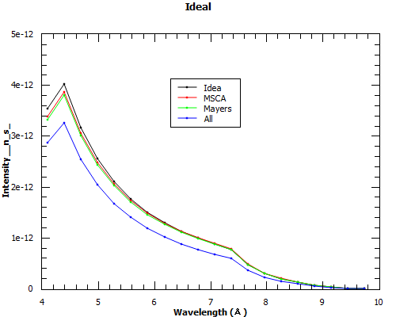
Investigation with McStas
Disclaimer: Some potential flaws in this analysis. See full report for a discussion of this or ask at the end

Slide 11
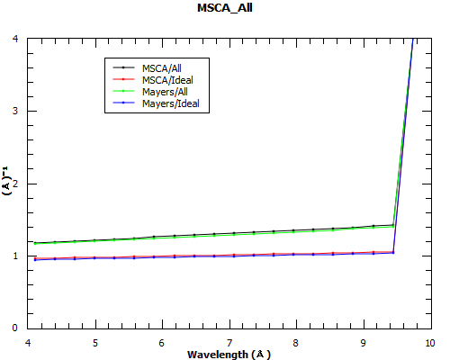
Investigation with McStas

Slide 12
Further Information
McStas
  http://www.mcstas.org
Slides and full report
  https://github.com/mantidproject/documents/tree/master/Presentations/Multiple%20Scattering%20Presentation

Slide 13

Questions?

Slide 14
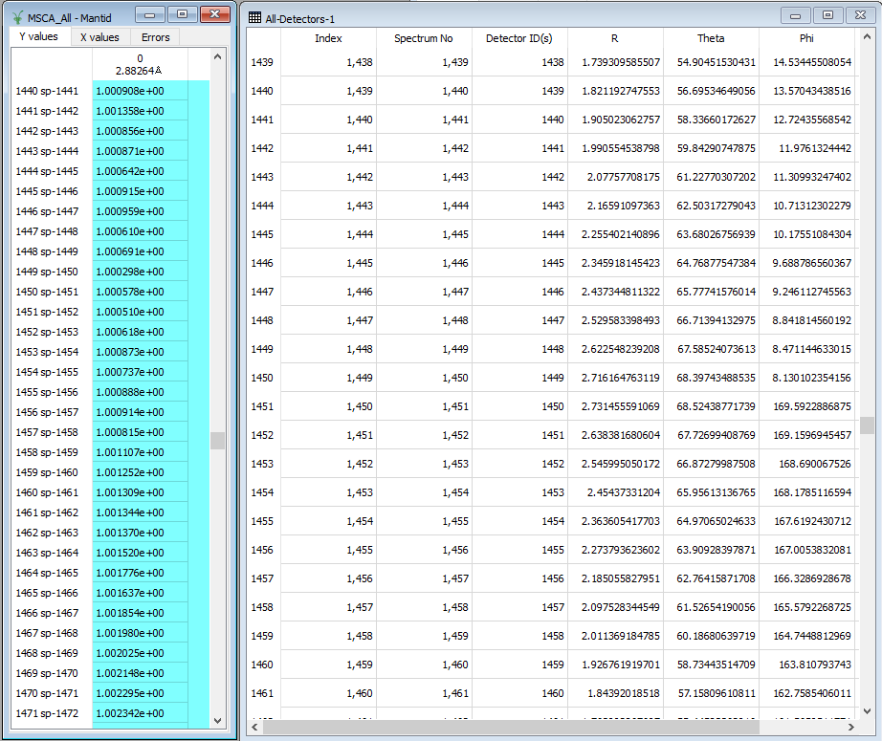
Why might the investigation be flawed?

